Slide 1
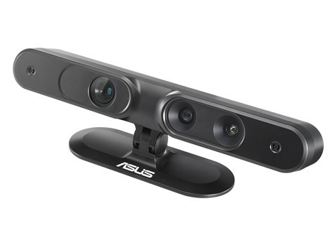
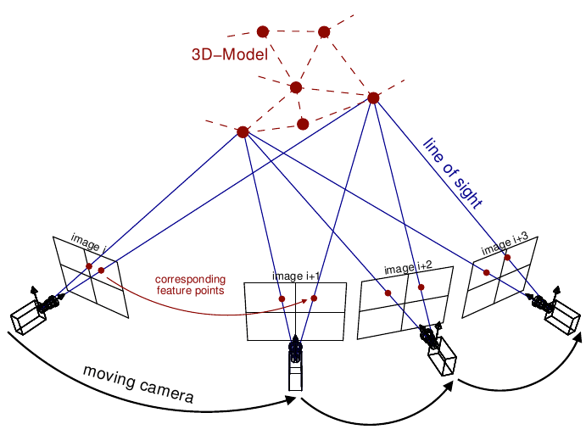
Picture courtesy: Van Riel, Sjoerd, “Exploring the use of 3D GIS as an analytical tool in archaeological excavation practice,” June 2016.
Structure from Motion and RGBD Depth Fusion
RGBD Sensor
Authors: Akash Chandrashekar†, Andrew Willis†, Jamie Gantert‡
SoutheastCon 2018
SfM

Slide 2
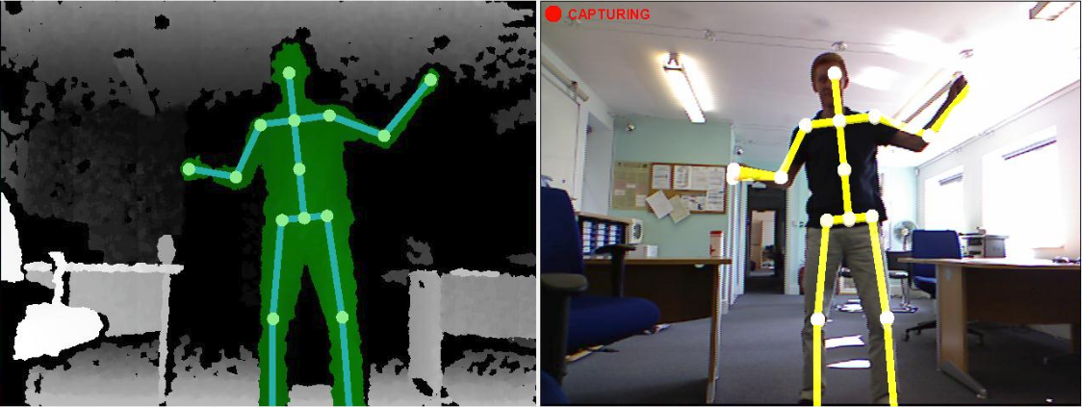
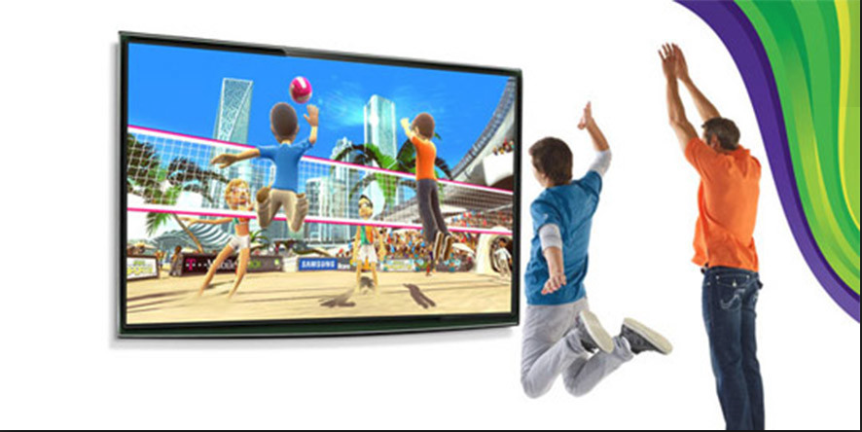
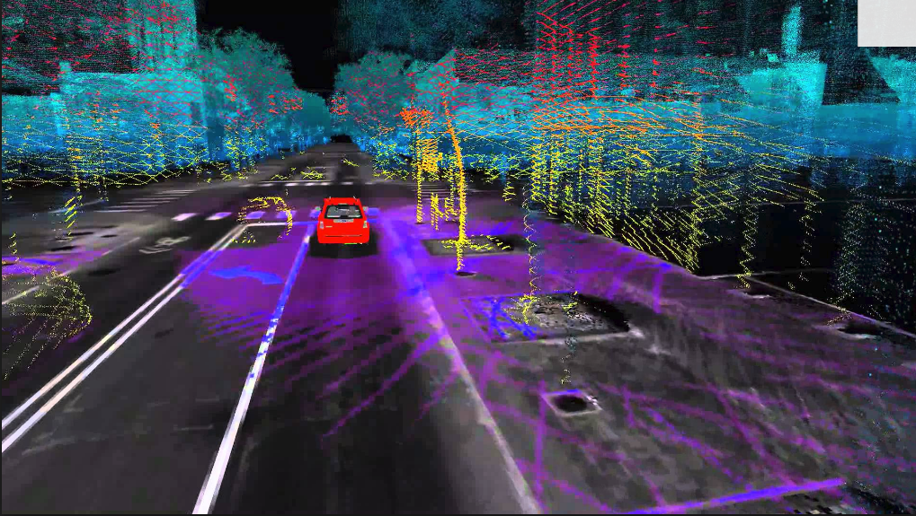
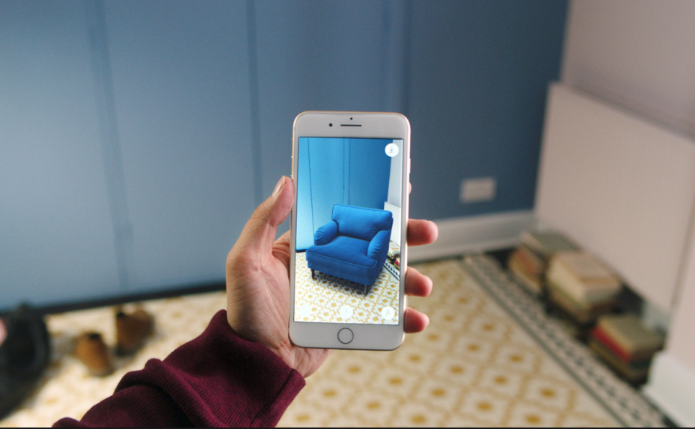
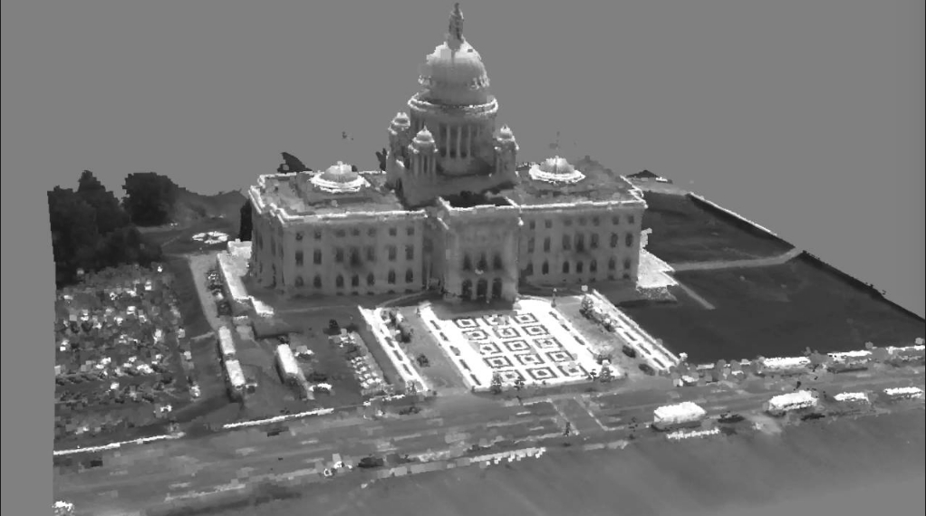
Applications of depth maps
Mapping and localization
Autonomous navigation/guidance
Augmented Reality
Interactive Gaming
Object Recognition
Motion capture
3D reconstruction
Picture courtesy: Google images

Slide 3
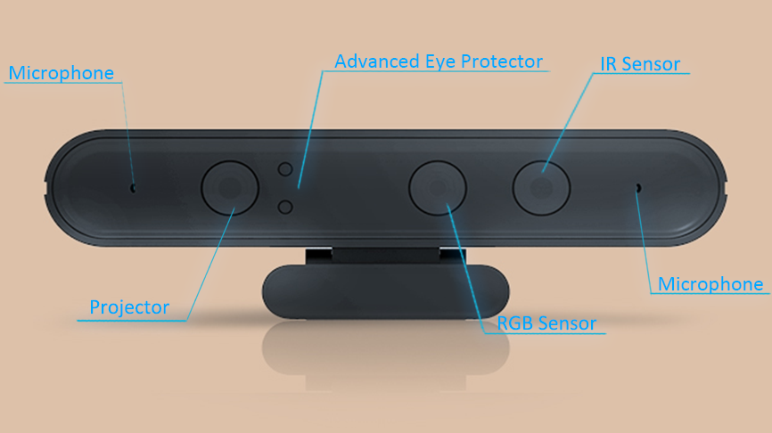
RGBD Sensors
Simultaneously capture color “RGB” images and the depth “D” images of the scene.
Relies on structured light technology to measure the depth of the scene.
Along with the traditional camera (RGB sensor) it has a infrared (IR) projector and a infrared (IR) sensor.
We have used Orbbec Astra RGBD sensor.
Has a field of view of 60° horiz x 49.5° vert.
Captures RGB images of dimension 640 * 480 @ 30FPS.
Captures depth images of dimension 640 * 480 @ 30FPS.
Has range of 0.6 - 8 m.
Picture courtesy: Google images

Slide 4
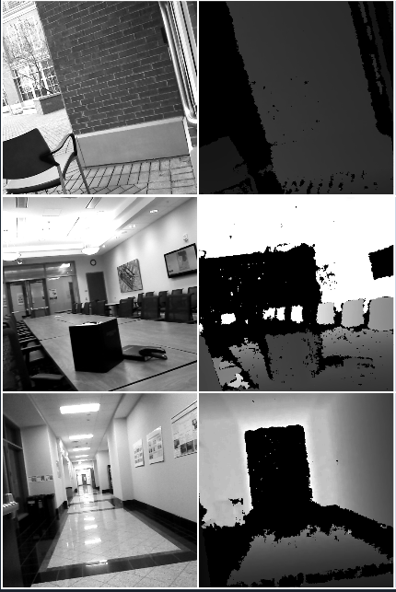
Limitations of RGBD Sensors
RGBD sensors often fail to provide meaningful depth values in sunlit outdoor scenes.
RGBD sensors also fails in sunlit indoor scenes.
RGBD sensors have range limitation (~8m).
RGBD sensors fail to collect measurements from from surfaces having specific reflectance properties like
Dark surfaces
Specular, mirror-like
Transparent surfaces

Slide 5
Structure From Motion (SfM)
The Structure from Motion (SfM) is a photogrammetric approach to estimate the three dimensional structure of a scene from a time series of RGB images.
The SfM consequently solves for two groups unknowns.
Relative pose of the camera between the frames , each poses are represented in Sim(3) with 7 degree of freedom.
Depth of 3D structure at all valid pixels , potentially there are w * h posible depths for each frame, where w and h are width and height of the frame .
Picture courtesy: Van Riel, Sjoerd, “Exploring the use of 3D GIS as an analytical tool in archaeological excavation practice,” June 2016.

Slide 6
Limitations of SFM
Scale of the estimated depth is always unknown.
If the errors are not handled, there will be a drift in the camera motion estimation and consequent depth estimation.
Computationally expensive.

Slide 7
LSD SLAM
We are using LSD-SLAM as our SfM implementation.
The LSD-SLAM iteratively performs the below steps on every new frame:
Image correspondence
Pose estimation
Depth estimation
Perform global optimization and loop closure

Slide 8
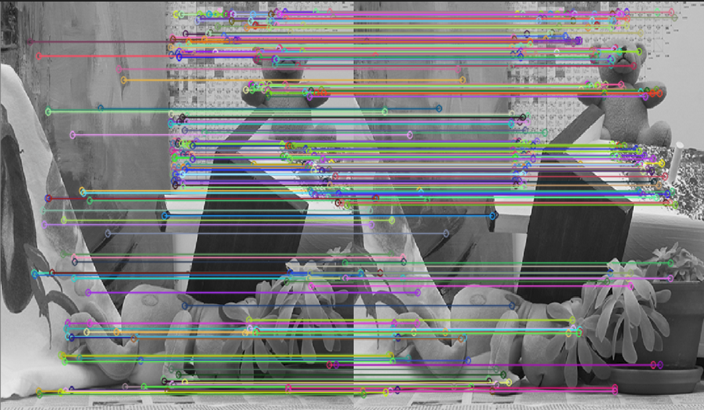
LSD SLAM 1: Image Correspondence
The problem of finding which parts of one image correspond to which parts of another image.
The differences are due to movement of the camera.
The correspondence are determined mainly by two different approaches
Direct Method : By using image intensities.
In-Direct Method : By using only key features.
LSD SLAM uses the direct method.
Picture courtesy: Google images

Slide 9
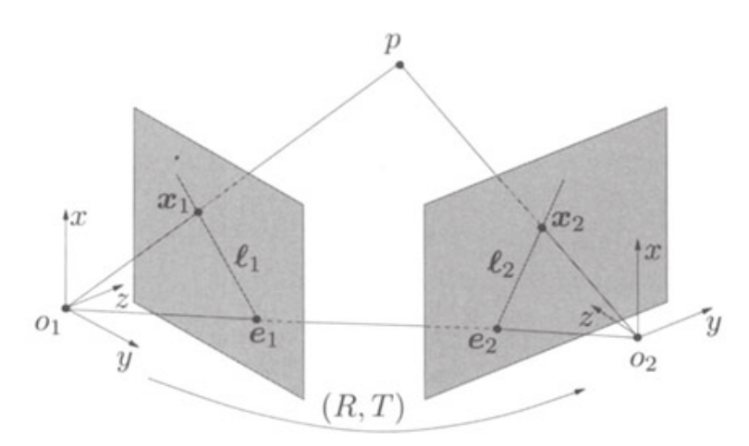
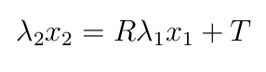
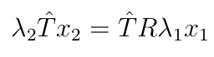
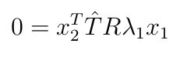
LSD SLAM 2: Pose Estimation
The pose change between frames are represented by Rotation R and translation T.
The known image correspondence between pair of images (x1 and x2) and associated 3D point p are constrained to be in a same plane called epipolar plane and this constraint is called the epipolar constraint.
With the unknown scales of λ1 and λ2, the epipolar constraint is represented as below.
Picture courtesy: Y. Ma, S. Soatto, J. Kosecka, and S. S. Sastry, An Invitation to 3-D Vision: From Images to Geometric Models. Springer Verlag, 2003.

Slide 10
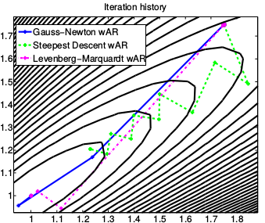
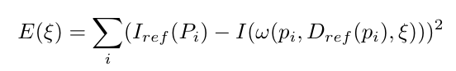
Nonlinear Optimization
The epipolar constraint is subjected to nonlinear optimization in order to estimate the unknown relative pose and unknown scale.
It is iterative methods which tries to minimize the squared 2-norm of residuals called the reprojection error.
Can be solved by one of the following iterative methods
Gradient descent
Gauss-Newton
Levenberg-Marquardt
Picture courtesy: Google images

Slide 11
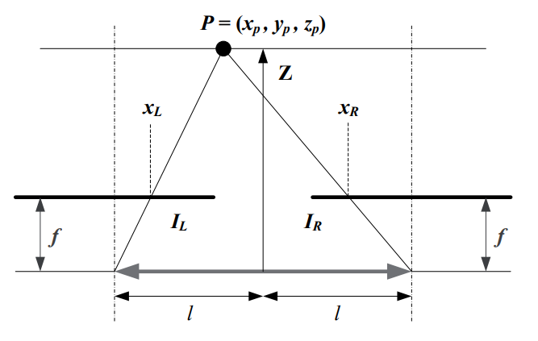
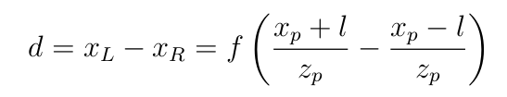
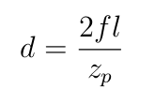
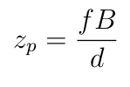
LSD SLAM 3: Depth Estimation
The LSD SLAM estimates depth by disparity mapping.
The amount of distance that the object have shifted from first image to second is called the disparity.
Picture courtesy: Google images

Slide 12
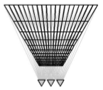
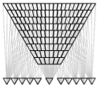
Multi-View Reconstruction
The problem with the fixed baseline disparity computation is that the error grows quadratically with depth.
The nearer depths have better accuracy but not the further depths
This can addressed efficiently by using variable baseline/resolution instead of fixed baseline
Further performance and accuracy improvements could be achieved by using probabilistic approach of adaptive baseline
Picture courtesy: D. Gallup, J. M. Frahm, P. Mordohai, and M. Pollefeys, “Variable baseline/resolution stereo,” in 2008 IEEE Conference on Computer Vision and Pattern Recognition, pp. 1–8, June 2008.

Slide 13
LSD-SLAM 4 : Graph Optimization
Efficient way to solve a complex nonlinear optimization problem is to represent them in graphs.
Takes advantage of sparse representation of the graph.
Images are represented as nodes.
Relative pose between images are the constraint / edges between nodes.
Helps solve loop closure and global optimization.

Slide 14
LSD SLAM Overview
LSD SLAM is a semi-dense, direct method.
It provides as output a reconstruction of the observed 3D environment as a pose-graph.
Direct correspondences are found between every RGB frame and each RGB keyframe to estimate the keyframe-to-RGB-frame relative camera pose.
The current tracked frame is promoted as a keyframe when there is drastic pose change between them, and depth map from previous keyframe is propagated to the new keyframe and regularized.
The depths are computed by finding the epipolar lines between new tracking frame and reference frames, along which the disparity for the pixel is determined.
The depth computations solves for two error sources, the geometric disparity error and the photometric disparity error.

Slide 15
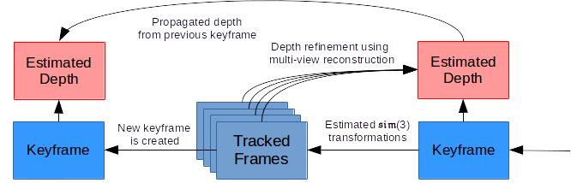
LSD SLAM pipeline

Slide 16
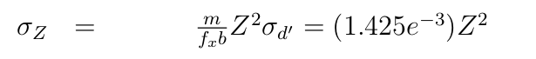
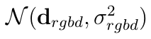
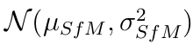
Noise Models
RGBD sensors provides depth measurements wherever it does not fail.
It is empirically observed that that a Gaussian noise model provides a good fit to observed measurement errors on planar targets, with mean zeros and sigma as below
With this variance, the sensor depth measurement at every pixel is represented as
LSD SLAM also provides the Gaussian noise model for estimated depth, which is represented as

Slide 17
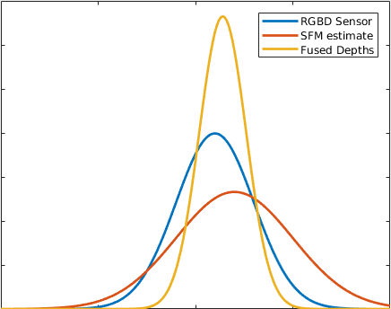
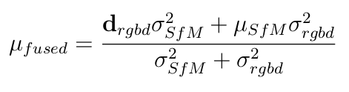
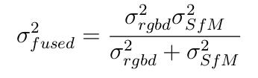
Depth Fusion
Depths are fused by gaussian multiplication which provides better standard deviation.

Slide 18
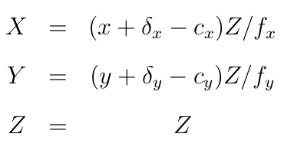
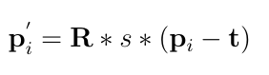
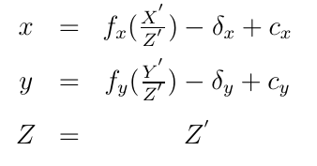
How to Compute Fused Depth at every frame
LSD SLAM generates depths only for keyframes.
However, LSD SLAM estimates the relative pose for every tracked frames.
Depth at very frames are extrapolated as following.
Depth from keyframes are un-projected into a point cloud.
The point cloud is transformed by the estimated relative pose.
Transformed point cloud is projected to the depth map at current tracked frame.

Slide 19
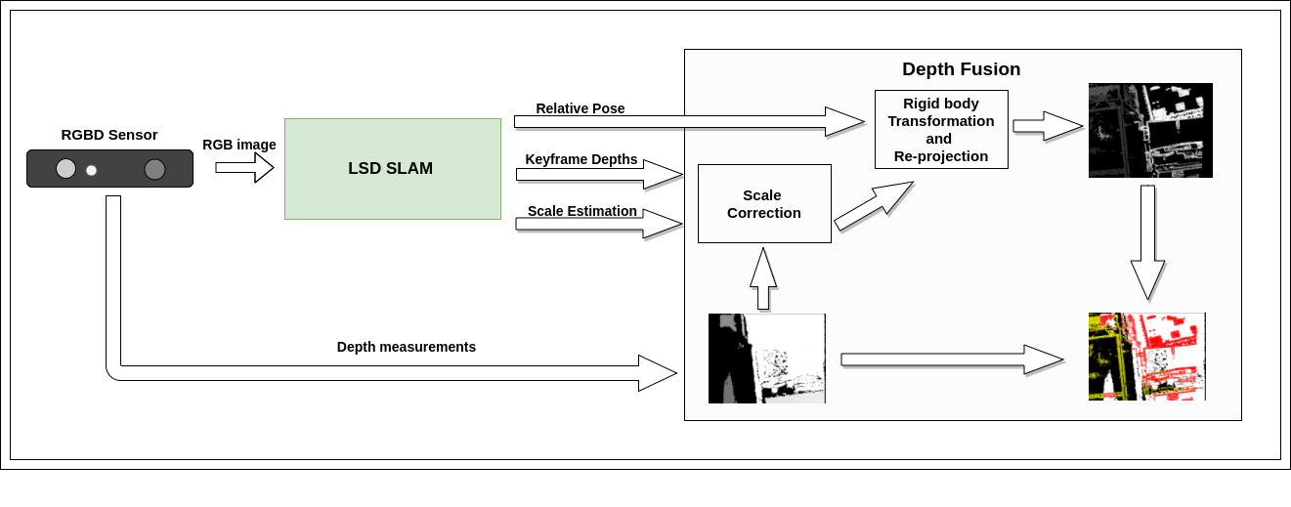
Depth Fusion pipeline

Slide 20
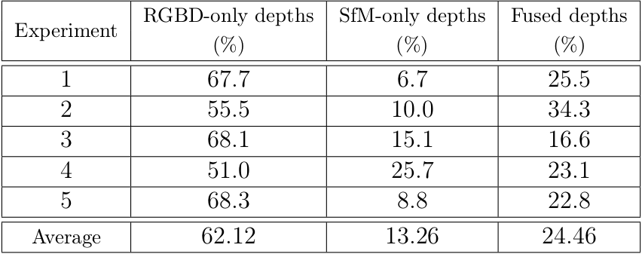
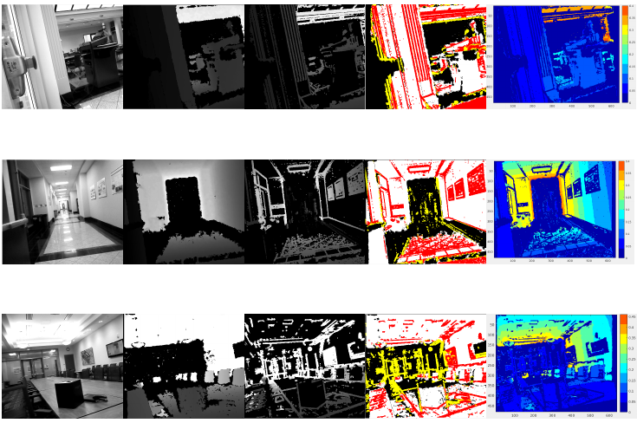
Results

Slide 21
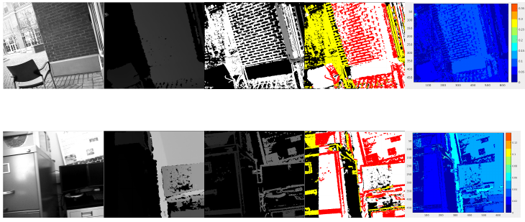
Results Continued

Slide 22
Conclusion
The SfM depth estimation complements the RGBD sensor measurements.
The depth fusion algorithm provides the effective way to augment the RGBD depth stream.
Results in improved depth images, with approximately 24% of the fused depths and about 13% of novel depths from the SfM algorithm alone.

Slide 23
Further work
The depth fusion can be generalized to address the non-Gaussian noise distributions.
Back-propagation of RGBD-SfM fused depth imagery into the SfM algorithm can be exploited to improve the camera pose estimation in the camera pose graph.
Preprocessing of RGBD depth measurements to get rid of noisy speckles especially for outdoor measurements.

